Slide 1

Chapter 14
User Datagram
Program
(UDP)
Copyright © The McGraw-Hill Companies, Inc. Permission required for reproduction or display.

Slide 2
OBJECTIVES:
To introduce UDP and show its relationship to other protocols in the TCP/IP protocol suite.
To explain the format of a UDP packet and discuss the use of each field in the header.
To discuss the services provided by the UDP such as process-to-process delivery, multiplexing/demultiplexing, and queuing.
To show how to calculate the optional checksum and the sender the needs to add a pseudoheader to the packet when calculating the checksum.
To discuss how some application programs can benefit from the simplicity of UDP.
To briefly discuss the structure of the UDP package.

Slide 3
Chapter
Outline
14.1 Introduction
14.2 User Datagram
14.3 UDP Services
14.4 UDP Application
14.5 UDP Package

Slide 4
14-1 INTRODUCTION
Figure 14.1 shows the relationship of the User Datagram Protocol (UDP) to the other protocols and layers of the TCP/IP protocol suite: UDP is located between the application layer and the IP layer, and serves as the intermediary between the application programs and the network operations.

Slide 5
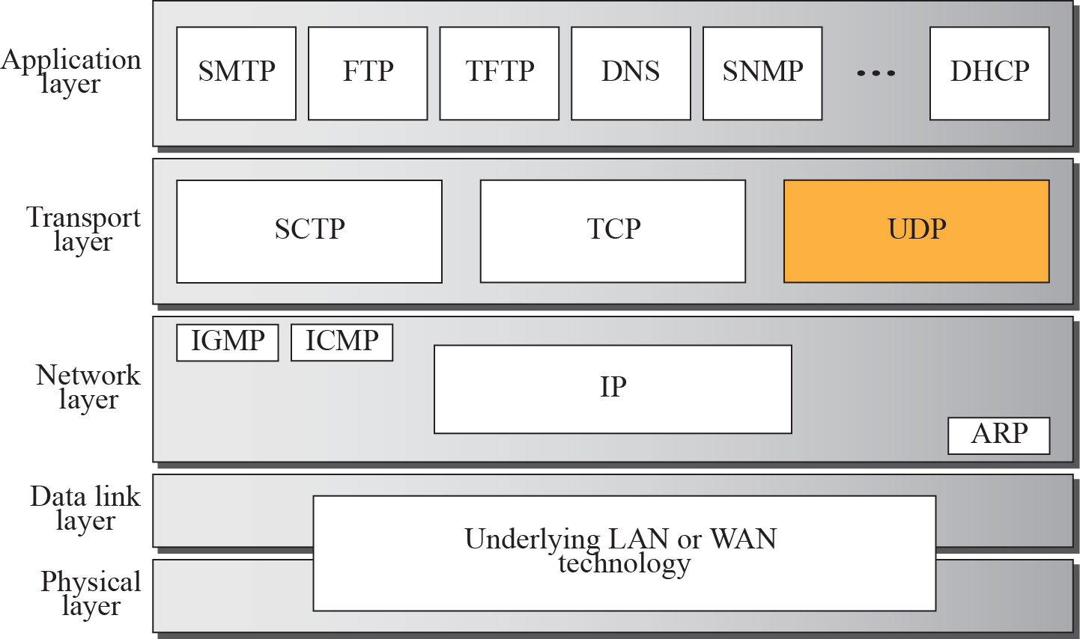
Figure 14.1 Position of UDP in the TCP/IP protocol suite

Slide 6
14-2 USER DATAGRAM
UDP packets, called user datagrams, have a fixed-size header of 8 bytes. Figure 14.2 shows the format of a user datagram.

Slide 7
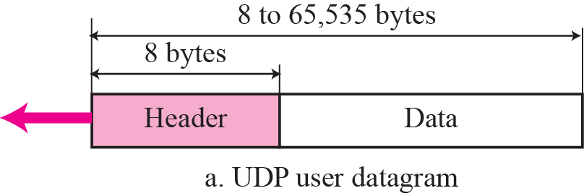
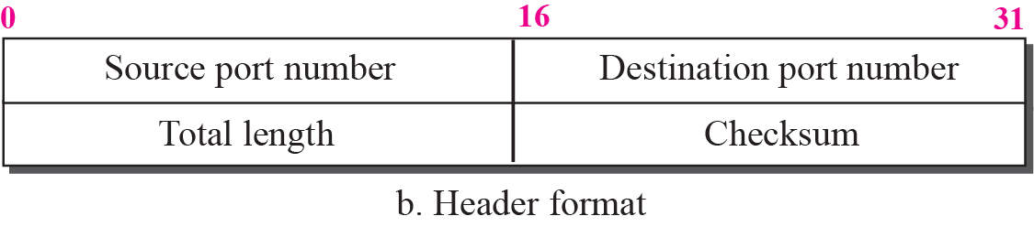
Figure 14.2 User datagram format

Slide 8
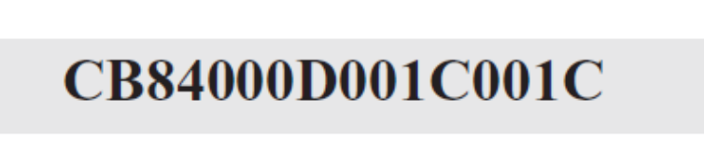
Example 14.1
The following is a dump of a UDP header in hexadecimal format.
a. What is the source port number?
b. What is the destination port number?
c. What is the total length of the user datagram?
d. What is the length of the data?
e. Is the packet directed from a client to a server or vice versa?
f. What is the client process?

Slide 9
Example 14.1 Continued
Solution
a. The source port number is the first four hexadecimal digits (CB84)₁₆ or 52100.
b. The destination port number is the second four hexadecimal digits (000D)₁₆ or 13.
c. The third four hexadecimal digits (001C)₁₆ define the length of the whole UDP packet as 28 bytes.
d. The length of the data is the length of the whole packet
minus the length of the header, or 28 – 8 = 20 bytes.
e. Since the destination port number is 13 (well-known port), the packet is from the client to the server.
f. The client process is the Daytime (see Table 14.1).

Slide 10
14-3 UDP Services
We discussed the general services provided by a transport layer protocol in Chapter 13. In this section, we discuss what portions of those general services are provided by UDP.

Slide 11
Topics Discussed in the Section
Process-to-Process Communication
Connectionless Service
Flow Control
Error Control
Congestion Control
Encapsulation and Decapsulation
Queuing
Multiplexing and Demultiplexing
Comparison between UDP and Generic Simple
Protocol

Slide 12
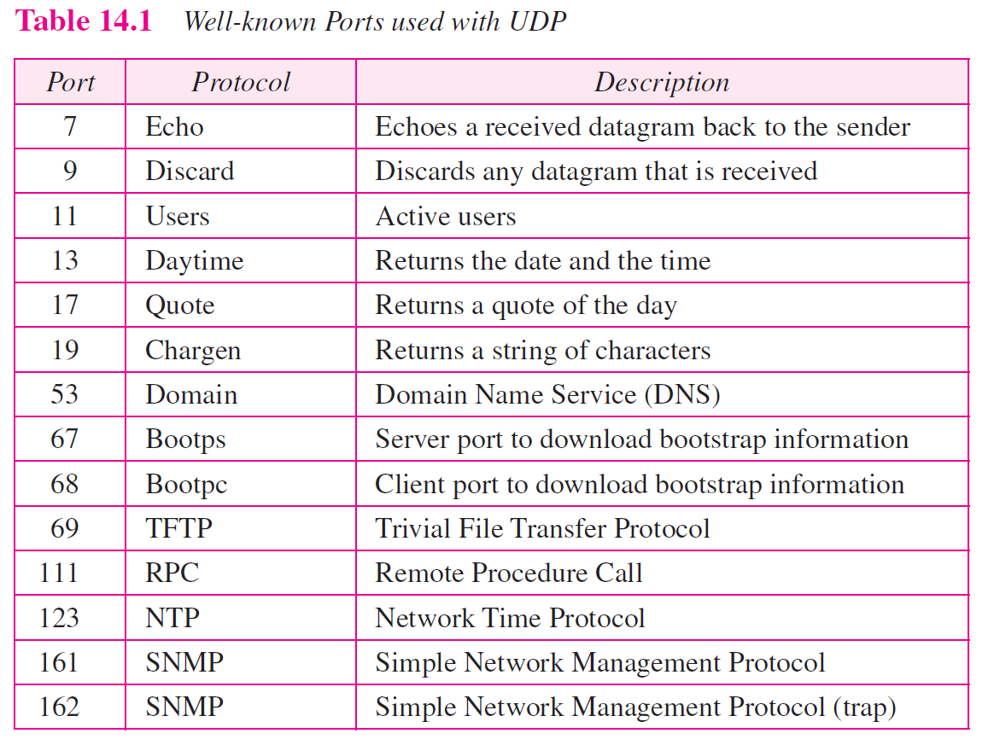

Slide 13
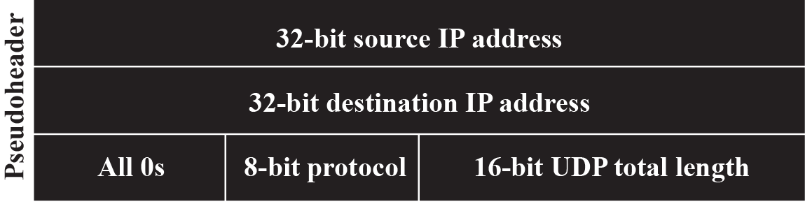
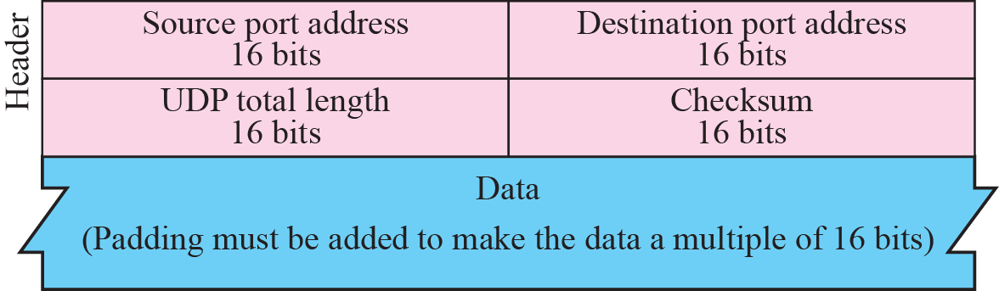
Figure 14.3 Pseudoheader for checksum calculation

Slide 14
Example 14.2
Figure 14.4 shows the checksum calculation for a very small user datagram with only 7 bytes of data. Because the number of bytes of data is odd, padding is added for checksum calculation. The pseudoheader as well as the padding will be dropped when the user datagram is delivered to IP (see Appendix F).

Slide 15
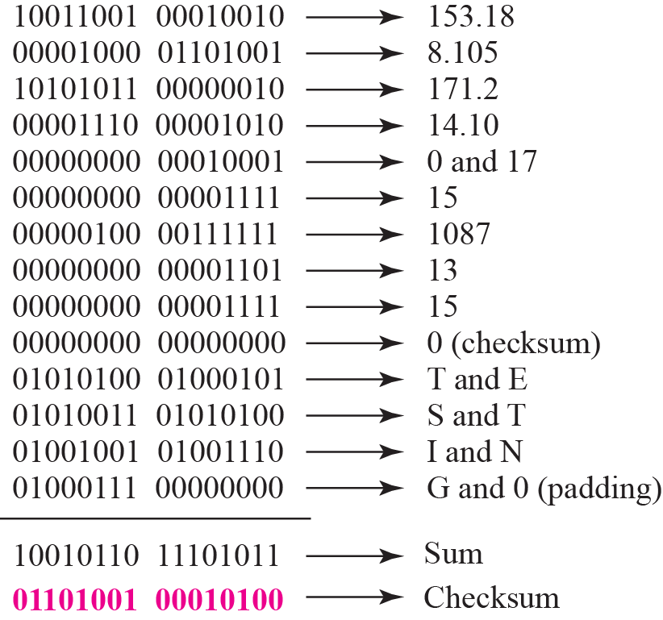
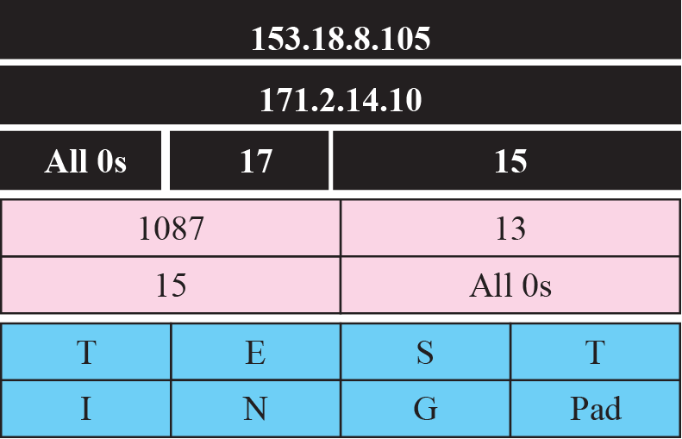
Figure 14.4 Checksum calculation for a simple UDP user datagram

Slide 16
Example 14.3
What value is sent for the checksum in one of the following hypothetical situations?
a. The sender decides not to include the checksum.
b. The sender decides to include the checksum, but the value of the sum is all 1s.
c. The sender decides to include the checksum, but the value of the sum is all 0s.

Slide 17
Example 14.3 Continued
Solution
a. The value sent for the checksum field is all 0s to show that the checksum is not calculated.
b. When the sender complements the sum, the result is all 0s; the sender complements the result again before sending. The value sent for the checksum is all 1s. The second complement operation is needed to avoid confusion with the case in part a.
c. This situation never happens because it implies that the value of every term included in the calculation of the sum is all 0s, which is impossible; some fields in the pseudoheader have nonzero values (see Appendix D).

Slide 18
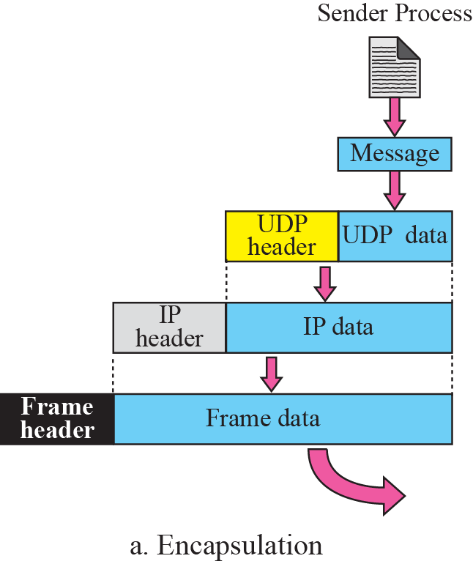
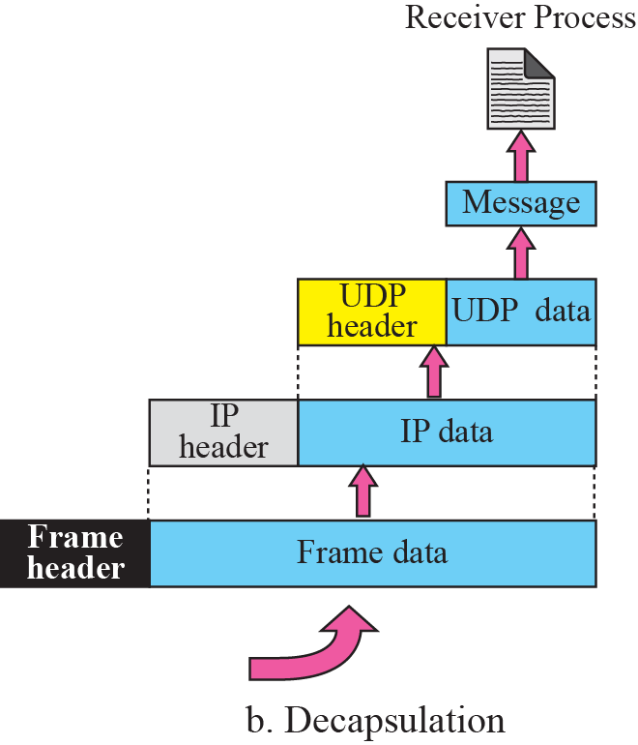

Figure 14.5 Encapsulation and decapsulation

Slide 19
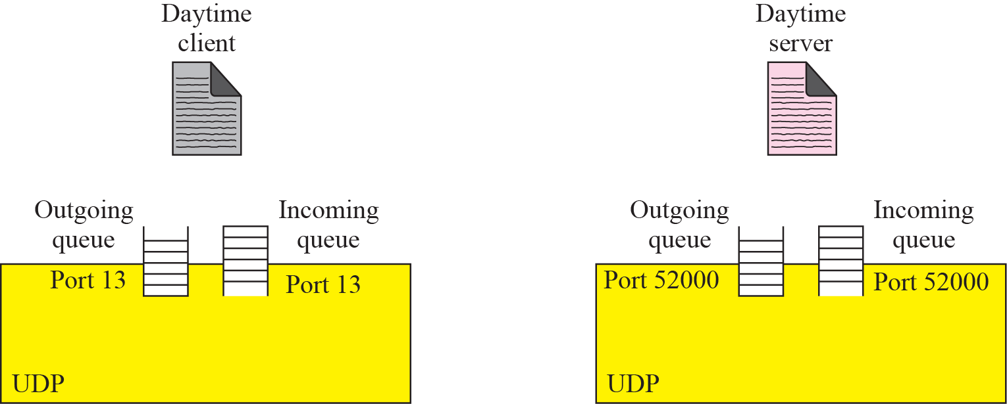





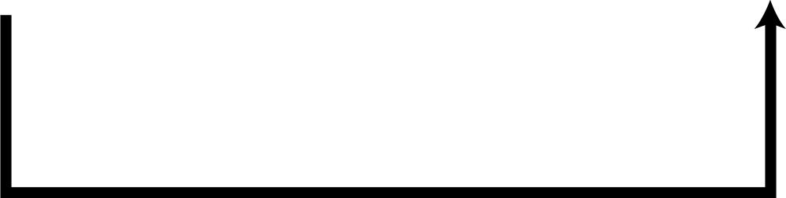
Figure 14.6 Queues in UDP

Slide 20
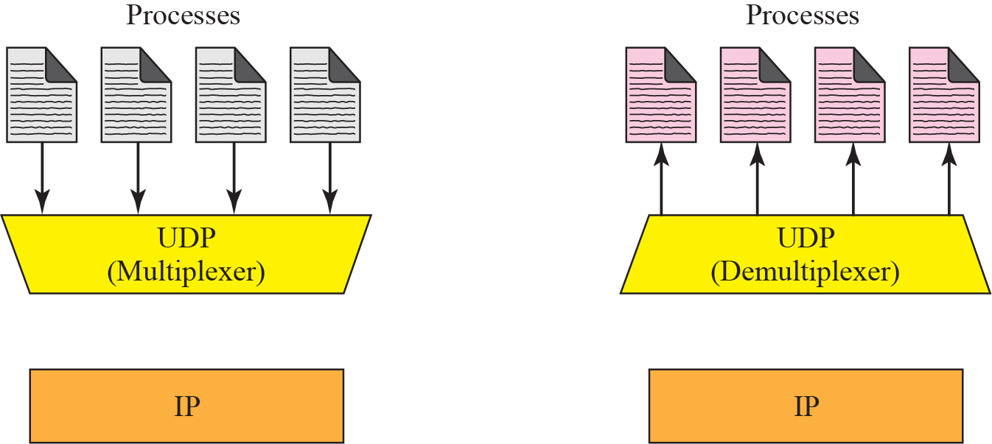





Figure 14.7 Multiplexing and demultiplexing

Slide 21

Note
UDP is an example of the connectionless simple protocol we discussed in Chapter 13 with the exception of an optional checksum added to packets for error detection.

Slide 22
14-4 UDP APPLICATION
Although UDP meets almost none of the criteria we mentioned in Chapter 13 for a reliable transport-layer protocol, UDP is preferable for some applications. The reason is that some services may have some side effects that are either unacceptable or not preferable. An application designer needs sometimes to compromise to get the optimum.

Slide 23
Topics Discussed in the Section
UDP Features
Typical Applications

Slide 24
Example 14.4
A client-server application such as DNS (see Chapter 19) uses the services of UDP because a client needs to send a short request to a server and to receive a quick response from it. The request and response can each fit in one user datagram. Since only one message is exchanged in each direction, the connectionless feature is not an issue; the client or server does not worry that messages are delivered out of order.

Slide 25
Example 14.5
A client-server application such as SMTP (see Chapter 23), which is used in electronic mail, cannot use the services of UDP because a user can send a long e-mail message, which may include multimedia (images, audio, or video). If the application uses UDP and the message does not fit in one single user datagram, the message must be split by the application into different user datagrams. Here the connectionless service may create problems. The user datagrams may arrive and be delivered to the receiver application out of order. The receiver application may not be able to reorder the pieces. This means the connectionless service has a disadvantage for an application program that sends long messages.

Slide 26
Example 14.6
Assume we are downloading a very large text file from the Internet. We definitely need to use a transport layer that provides reliable service. We don’t want part of the file to be missing or corrupted when we open the file. The delay created between the delivery of the parts are not an overriding concern for us; we wait until the whole file is composed before looking at it. In this case, UDP is not a suitable transport layer.

Slide 27
Example 14.7
Assume we are watching a real-time stream video on our computer. Such a program is considered a long file; it is divided into many small parts and broadcast in real time. The parts of the message are sent one after another. If the transport layer is supposed to resend a corrupted or lost frame, the synchronizing of the whole transmission may be lost. The viewer suddenly sees a blank screen and needs to wait until the second transmission arrives. This is not tolerable. However, if each small part of the screen is sent using one single user datagram, the receiving UDP can easily ignore the corrupted or lost packet and deliver the rest to the application program. That part of the screen is blank for a very short period of the time, which most viewers do not even notice. However, video cannot be viewed out of order, so streaming audio, video, and voice applications that run over UDP must reorder or drop frames that are out of sequence.

Slide 28
14-5 UDP PACKAGE
To show how UDP handles the sending and receiving of UDP packets, we present a simple version of the UDP package.
We can say that the UDP package involves five components: a control-block table, input queues, a control-block module, an input module, and an output module.

Slide 29
Topics Discussed in the Section
Control-Block Table
Input Queues
Control-Block Module
Input Module
Output Module

Slide 30
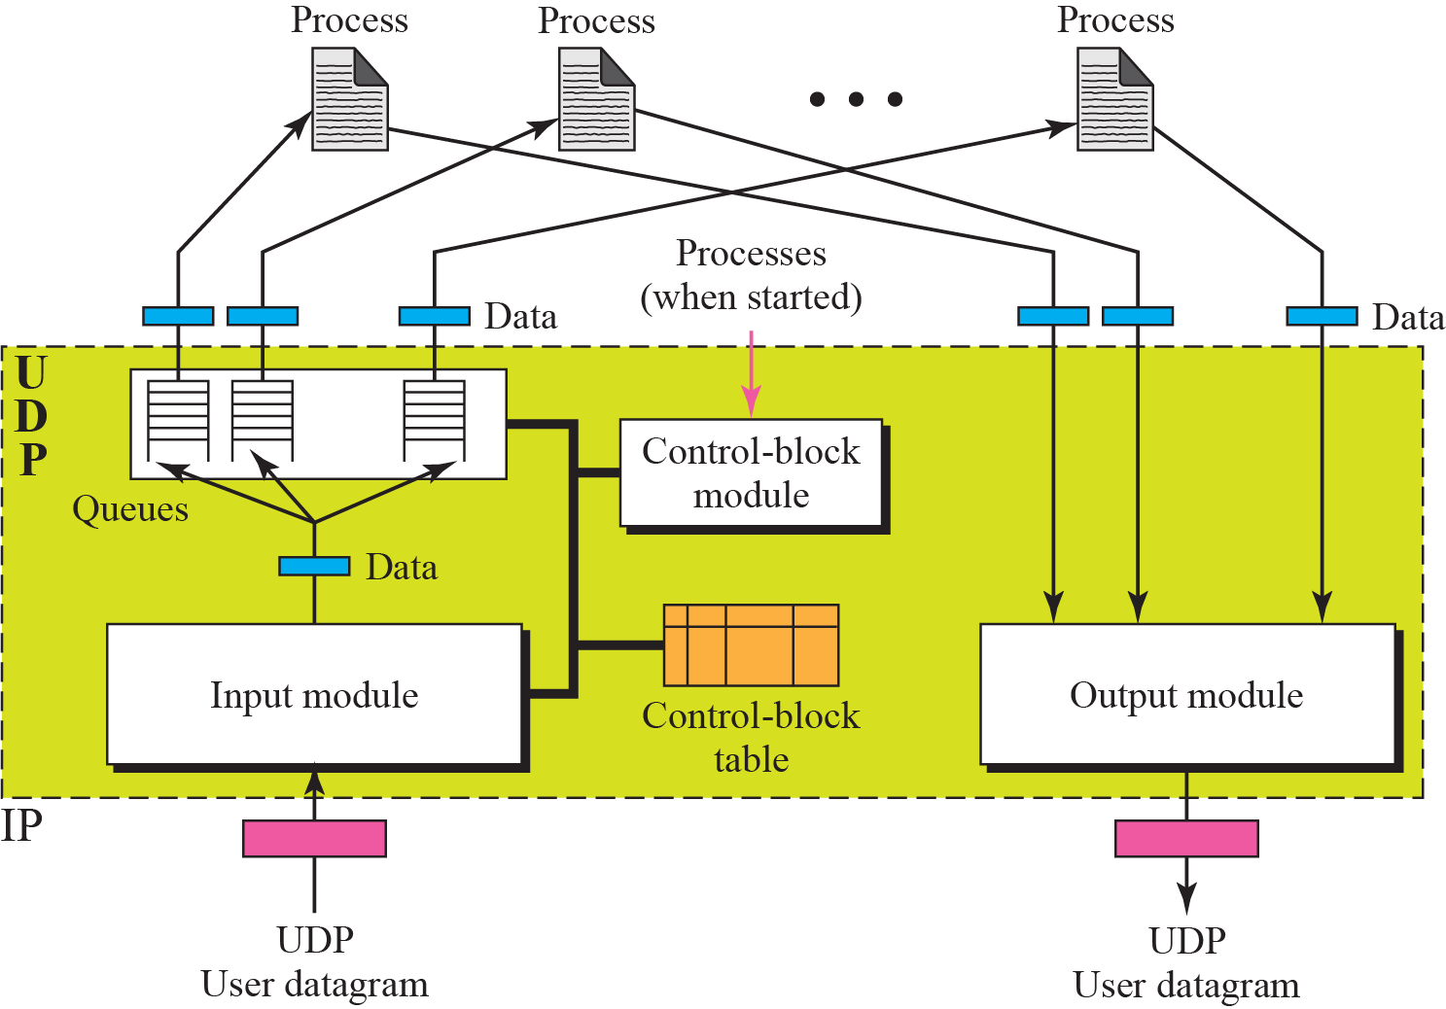
Figure 14.8 UDP design

Slide 31
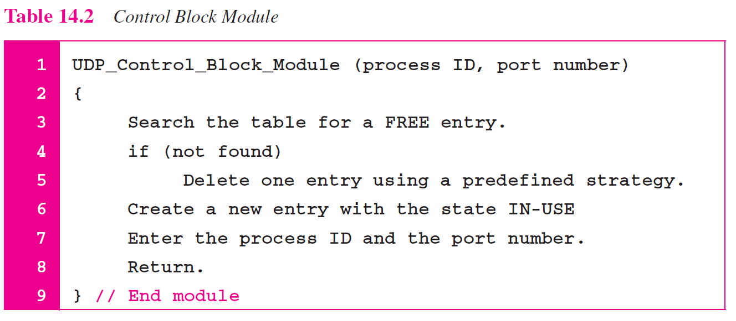

Slide 32
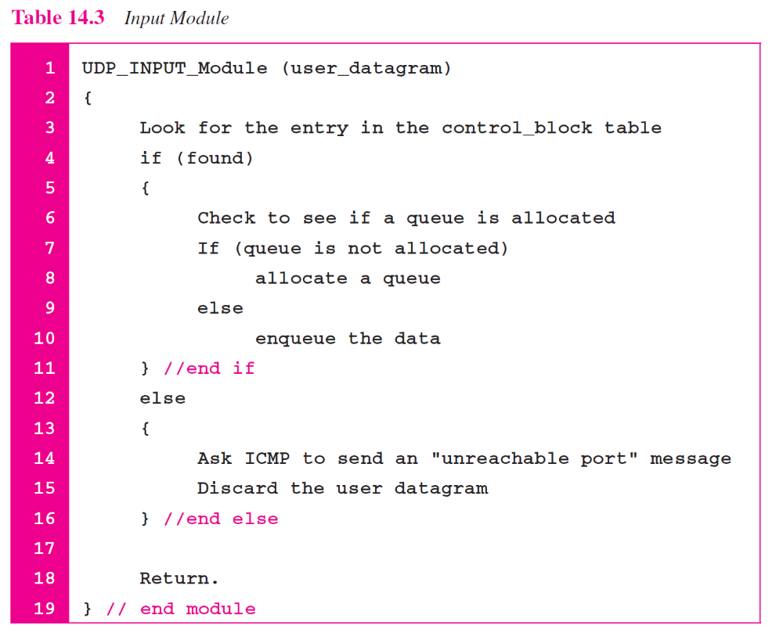

Slide 33
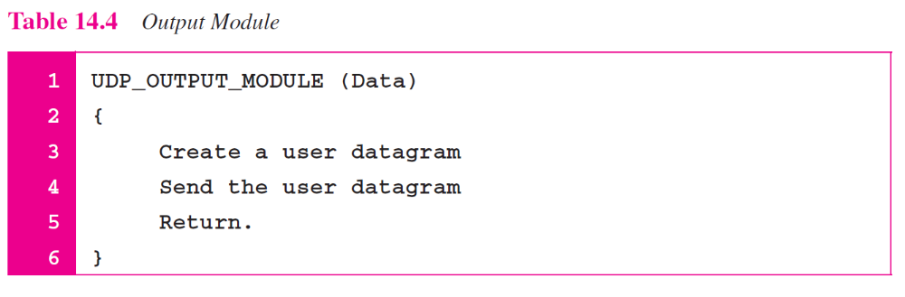

Slide 34
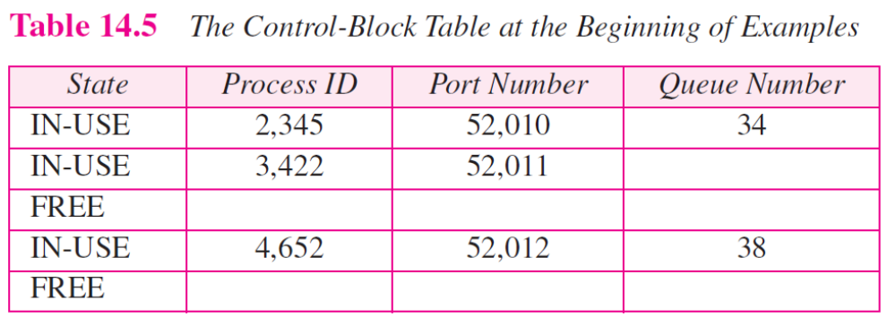

Slide 35
Example 14.8
The first activity is the arrival of a user datagram with destination port number 52,012. The input module searches for this port number and finds it. Queue number 38 has been assigned to this port, which means that the port has been previously used. The input module sends the data to queue 38. The control-block table does not change.

Slide 36
Example 14.9
After a few seconds, a process starts. It asks the operating system for a port number and is granted port number 52,014. Now the process sends its ID (4,978) and the port number to the control-block module to create an entry in the table. The module takes the first FREE entry and inserts the information received. The module does not allocate a queue at this moment because no user datagrams have arrived for this destination (see Table 14.6).

Slide 37
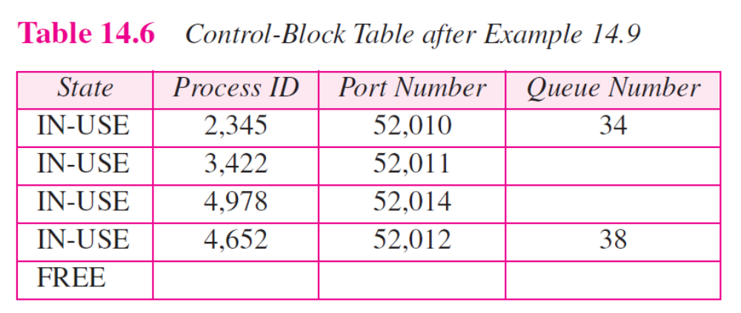

Slide 38
Example 14.10
A user datagram now arrives for port 52,011. The input module checks the table and finds that no queue has been allocated for this destination since this is the first time a user datagram has arrived for this destination. The module creates a queue and gives it a number (43). See Table 14.7.

Slide 39
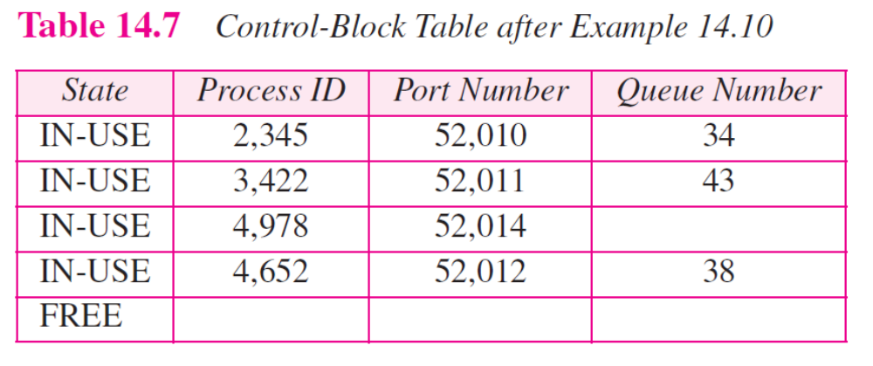

Slide 40
Example 14.11
After a few seconds, a user datagram arrives for port 52,222. The input module checks the table and cannot find an entry for this destination. The user datagram is dropped and a request is made to ICMP to send an unreachable port message to the source.

